Slide 1
Does RL Instill New Abilities In Models?
9/18/2025
Aidan Alme & Kaavya Chaparala

Slide 2
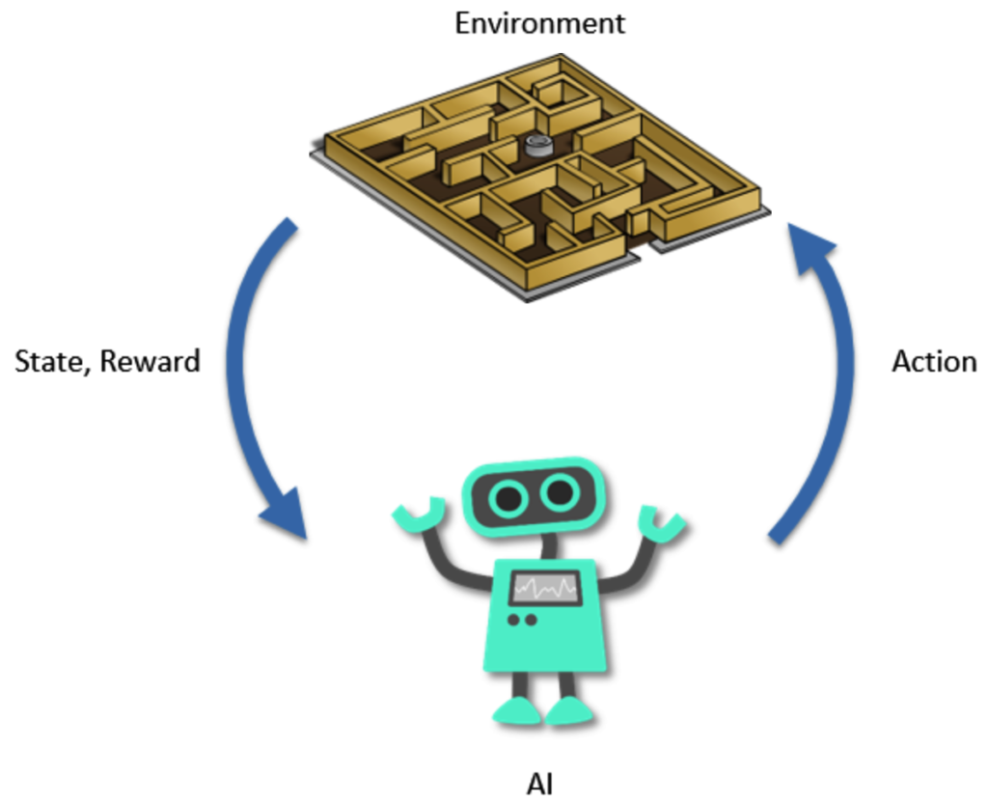
Why Reinforcement Learning? (Review From Class)
Adapt model to given task
Make the foundation model usable without losing grammaticality
Expand reasoning capabilities
Reinforce desired behavior
https://upload.wikimedia.org/wikipedia/commons/1/1b/Reinforcement_learning_diagram.svg

Slide 3
Does Reinforcement Learning improve reasoning capabilities beyond the base model?

Slide 4
Yes or no? What do you think?

Slide 5
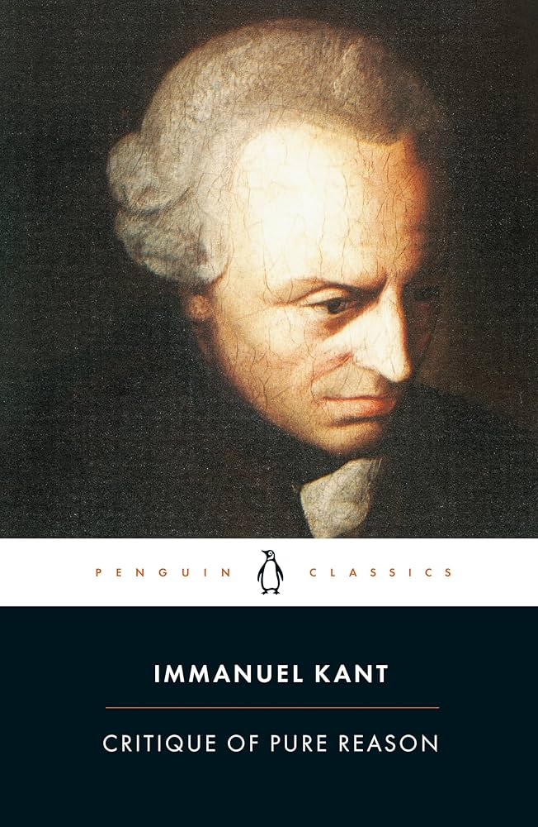
What is Reasoning?
Getting things correct?
Quid facti vs. quid juris
Product of general purpose cognitive abilities
Verbal, quantitative, spatial
Applicable to a class or set of problems
https://m.media-amazon.com/images/I/81HFexTeoXL._UF1000,1000_QL80_.jpg

Slide 6

Important Definitions
Action space:
Set of possible actions agent can take
Language space:
Embedding space / completions (?)
Chain of thought:
Prompt-engineering to break down task step-by-step
Compare: prompt-chaining
https://media.istockphoto.com/id/1096227330/photo/machine-learning-concept.jpg?s=612x612&w=0&k=20&c=bvV5DRZxWVXs80s3gUBCSwWnI8K2DNX1kEKa10P01Gk=

Slide 7
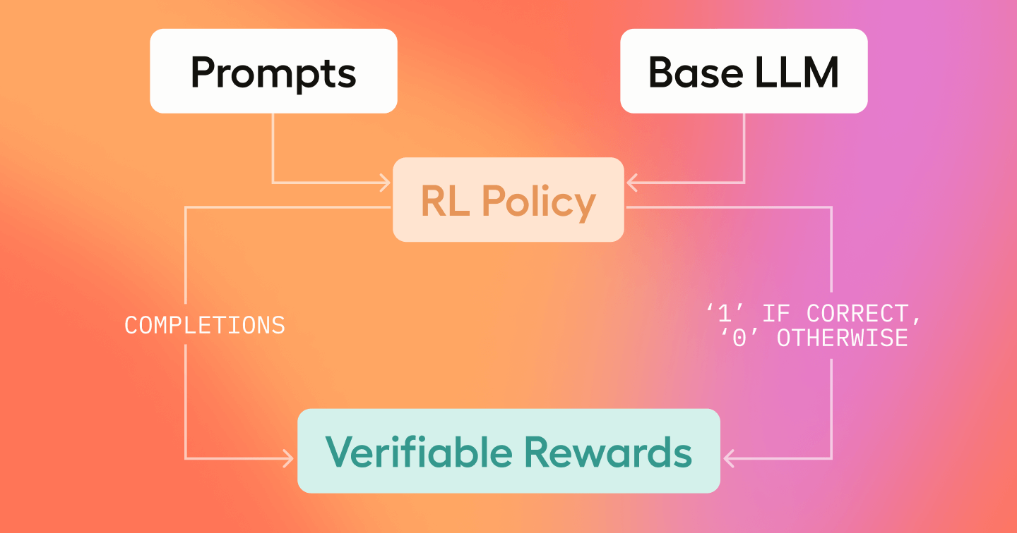
Reinforcement Learning with Verifiable Rewards
Objective outcome (right or wrong)
Mathematics, coding, etc.
Ground truth solution
Practical and easy to implement
Tasks involve general reasoning rather than facts or trivia
https://cdn.sanity.io/images/k7elabj6/production/a895a8986032ac0ab2155dacc3a4b7960010c90c-1440x756.png

Slide 8
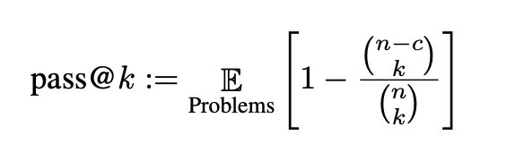
Important Definitions - pass@k
pass@k is the probability that at least one of the top k outputs generated given a prompt is correct
Used to assess model reasoning abilities
pass@1 looks at exact match correctness
Larger k values examine if the model can generate a wide range of valid outputs
https://arxiv.org/pdf/2107.03374

Slide 9
Paper & Contributions
ProRL
Limit of RLVR
Prolonged reinforcement learning
“The World’s Best 1.5B Reasoning Model”
Does RL expand model reasoning capabilities?
Analysis of pre-existing methods
Fine-tuned vs. aligned models
Pass@k sampling of responses
Does RLVR induce novel reasoning?

Slide 10
ProRL

Slide 11
ProRL - Prolonged Reinforcement Learning Method
Start with GRPO (Group Relative Policy Optimization)
Generate multiple outputs per query
Calculate a reward for how well each output answers the query
Calculate the advantage for each output
No need for separate ‘Value’ module !

Slide 12
ProRL - Details
KL regularization & clip higher
Reference Policy Reset
Prolonged RL training periods

Slide 13
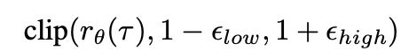
ProRL - KL Regularization & higher clipping
Similar to Tuesday’s DAPO paper, authors argue that higher clipping encourages exploration
, ϵ_{high} = 0.4
Unlike the DAPO paper, authors keep KL term
Base model = DeepSeek-R1-Distill-Qwen-1.5B, already well-initialized for CoT

Slide 14
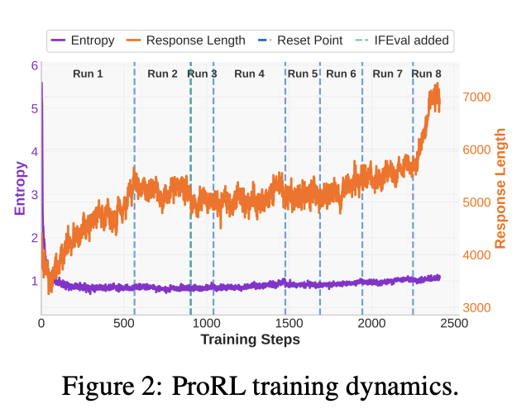
ProRL - Reference Policy Reset & Prolonged Training
Problem: As training progresses, KL penalty will grow and policy updates shrink, limiting the number of training steps that can be taken
Solution: When validation performance plateaus/worsens, reset the reference policy to more recent version of the online policy
context window increases
Resetting the reference policy enables prolonged training

Slide 15
ProRL - Results!

Slide 16
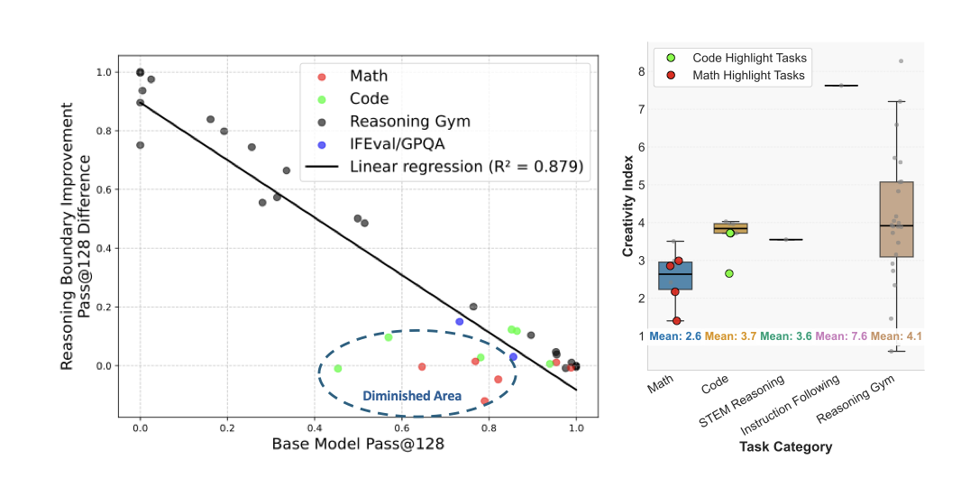
ProRL - Performance Compared to Base Model
ProRL expands model’s reasoning
boundary most on tasks where base model initially struggles.
Tasks with minimal
gains post-RL (in the circle) tend to have a
lower creativity index, indicating higher overlap with
pretraining data.

Slide 17
ProRL - Quantitative Results
Model | Average pass@1
ProRL | 60.14
Base Model | 63.19
Model | Average pass@1
ProRL | 37.49
Base Model | 23.08
Model | Average pass@1
ProRL | 52.29
Base Model | 3.49
Table 1. Comparison of average pass@1 score across benchmarks for Math domain
Table 1. Comparison of average pass@1 score across benchmarks for Code
Table 1. Comparison of average pass@1 score across benchmarks for STEM reasoning

Slide 18
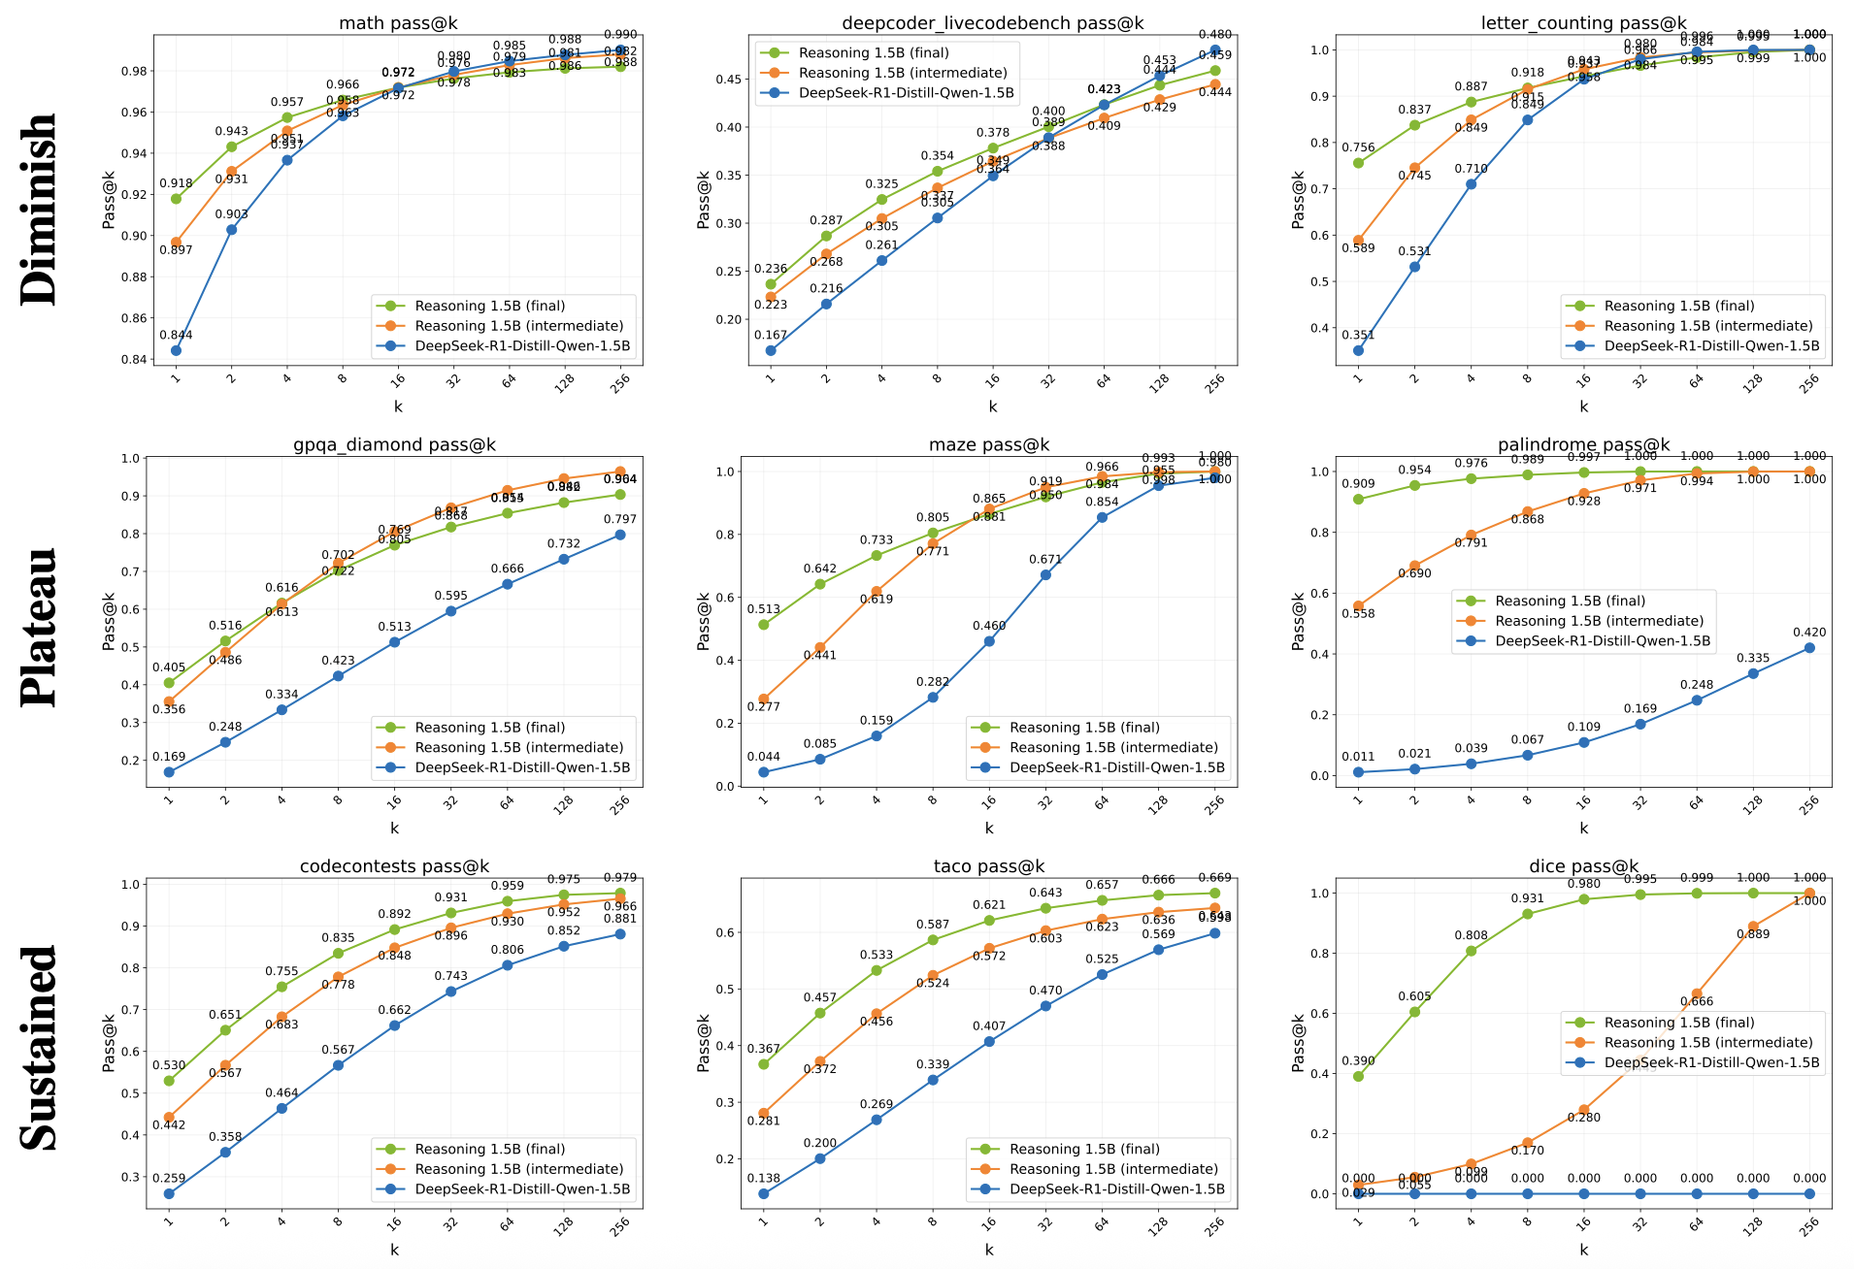
ProRL –
Pass@k
ProRL consistently surpasses base model at big and small k values

Slide 19
Limits of RLVR

Slide 20
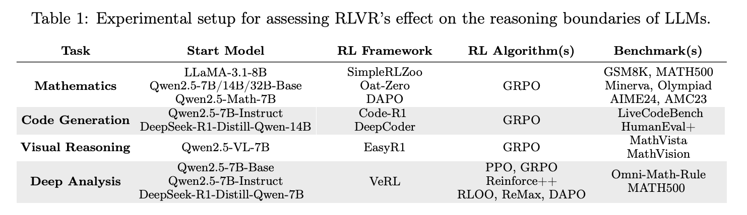
Limit of RLVR - Details
Does Reinforcement Learning Really Incentivize Reasoning Capacity in LLMs Beyond the Base Model?
Pass@k sample completions for base vs. aligned & check the proportion correct

Slide 21
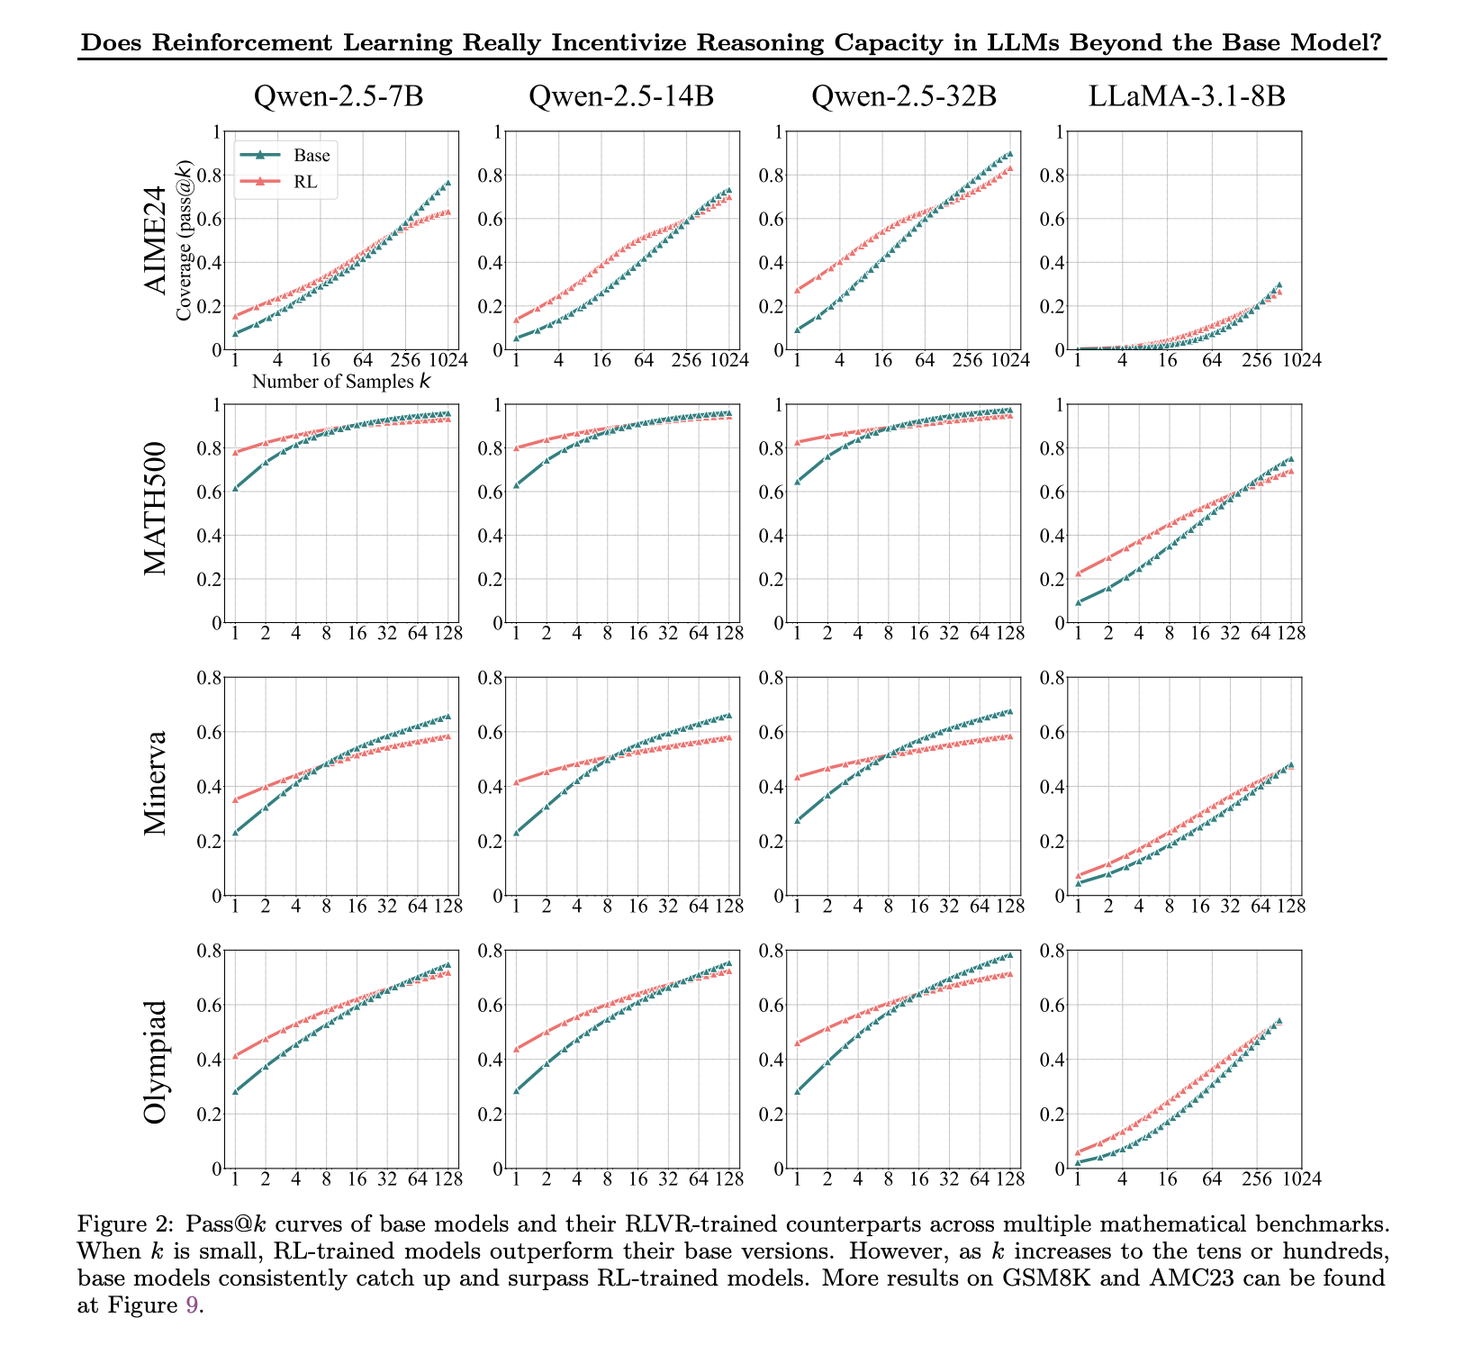
The proportion of correct samples from unaligned models surpasses the proportion from aligned ones for high enough k!

Slide 22
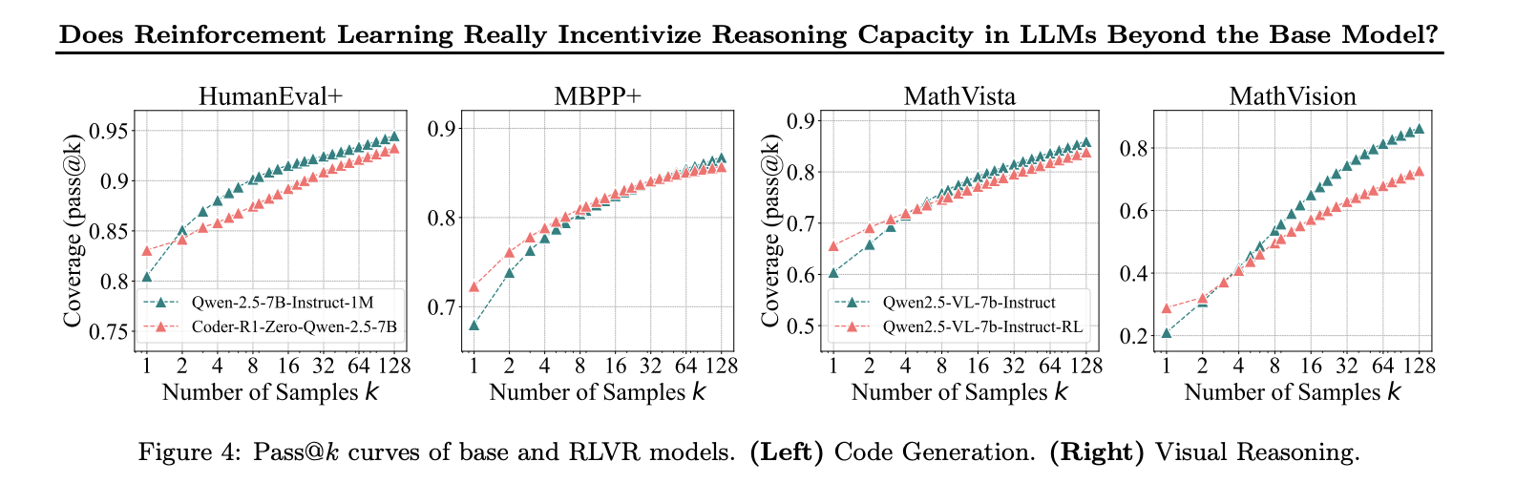
Closer look at the same phenomenon from last slide.
Notice the proximity in accuracy.

Slide 23
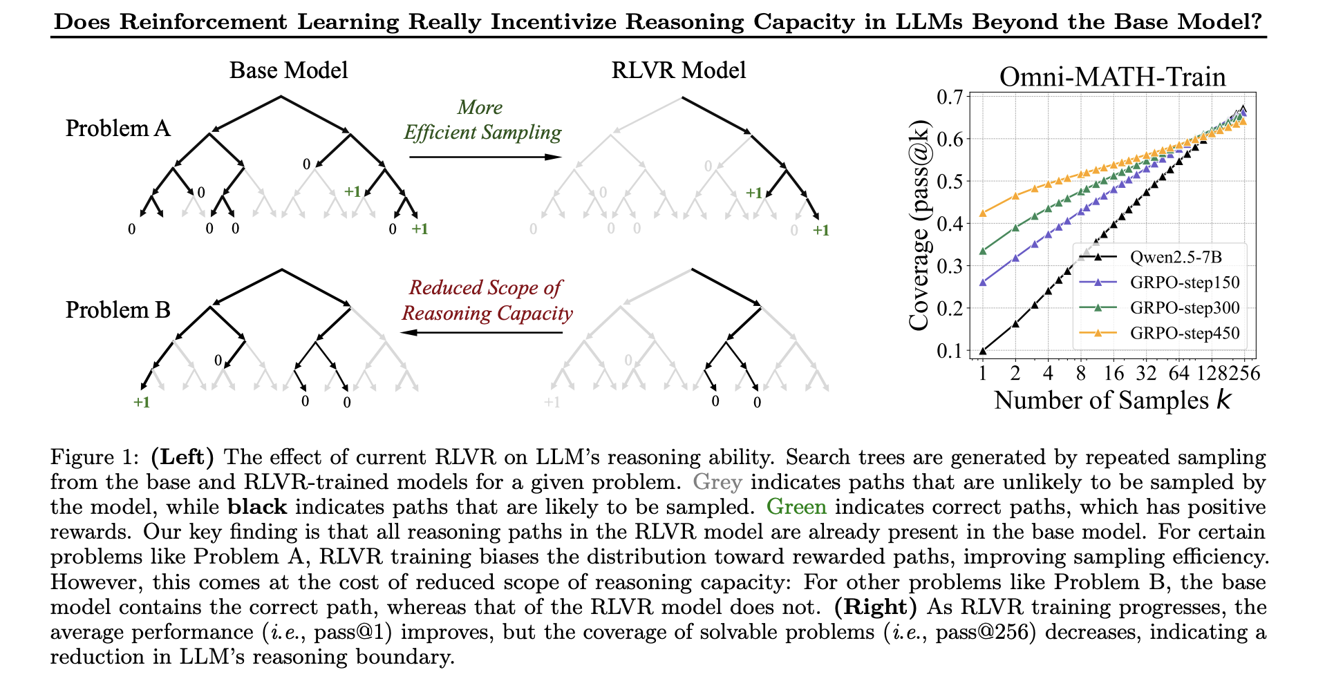
Pruning or reasoning?

Slide 24


Limit of RLVR - Details
Narrower reasoning - maximization of expectation?
Reasoning paths exist in base model - superset
Cannot solve new problems
Minor variation in RL / alignment algorithms
Distillation does cause improvement
Vast action space
Similar perplexity
https://www.vintagetreecare.com/wp-content/uploads/2014/01/tree-pruning.jpg
https://miro.medium.com/1*3DvSjCLORuexj3Y-G-r8hw.jpeg

Slide 25
Conclusions
ProRL
“The weaker the start the stronger the gain”
ProRL model is poorer on tasks where the base model already performed well
stronger on tasks where the tasks where base model was weak
Limit of RLVR
Capacity already present in base model
No new reasoning
Effective sampling
Reduced reasoning?

Slide 26
Does RL *really* instill reasoning capabilities?

Slide 27
Contradictory Results?

